Slide 1
Unit 7
Solving Systems of Equations by Substitution
Algebra 1

Slide 2
Solving Systems of Linear Equations by Substitution
STEPS
Solve one of the equations for y in terms of x.
Replace y in the second equation with the answer from Step 1.
Solve for x.
Replace x with its value from Step 3 in the first equation.
Solve y.

Slide 3
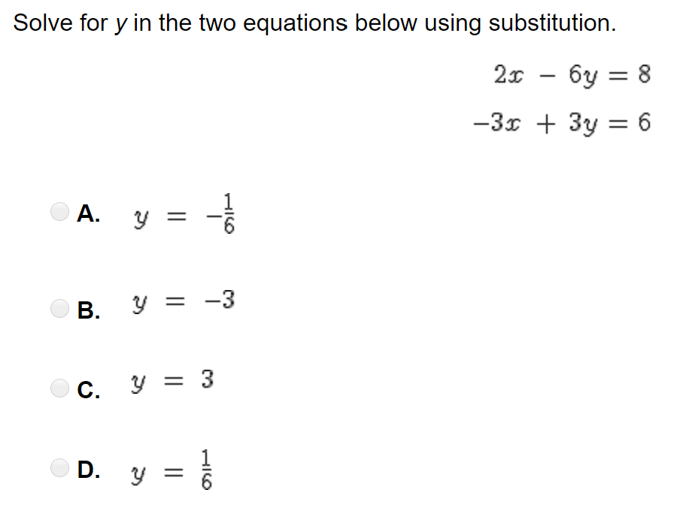
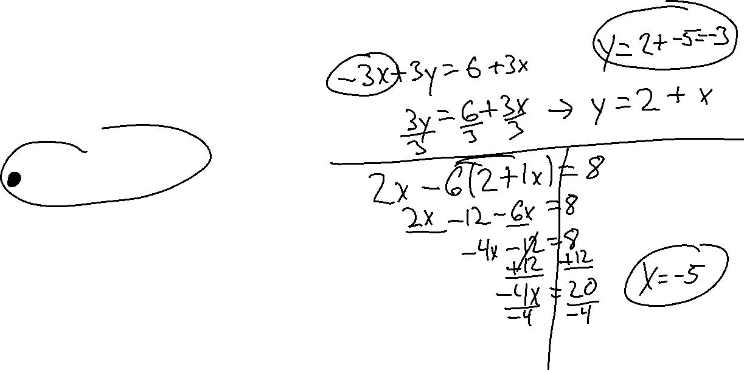

Slide 4
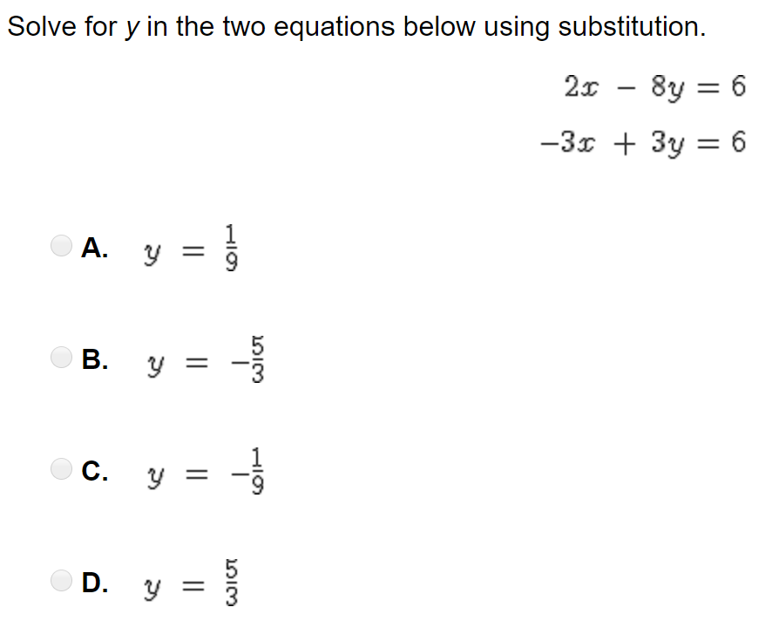
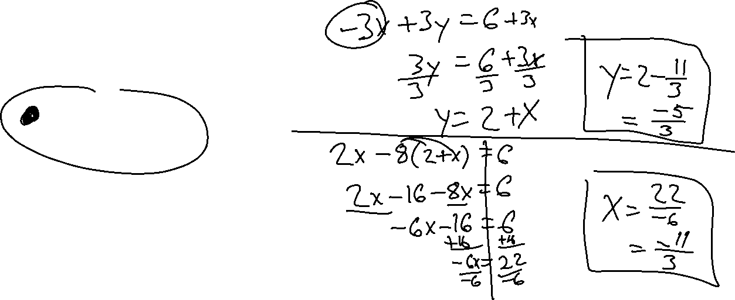

Slide 5
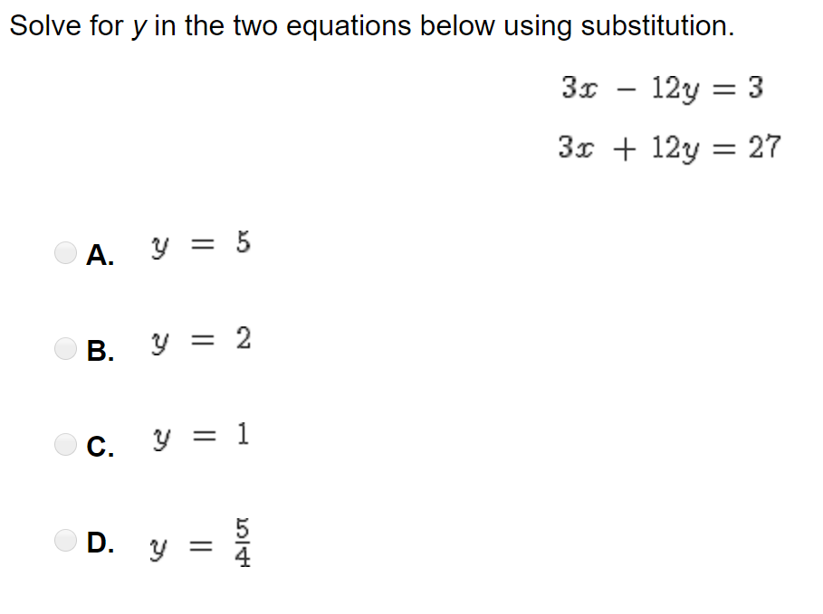
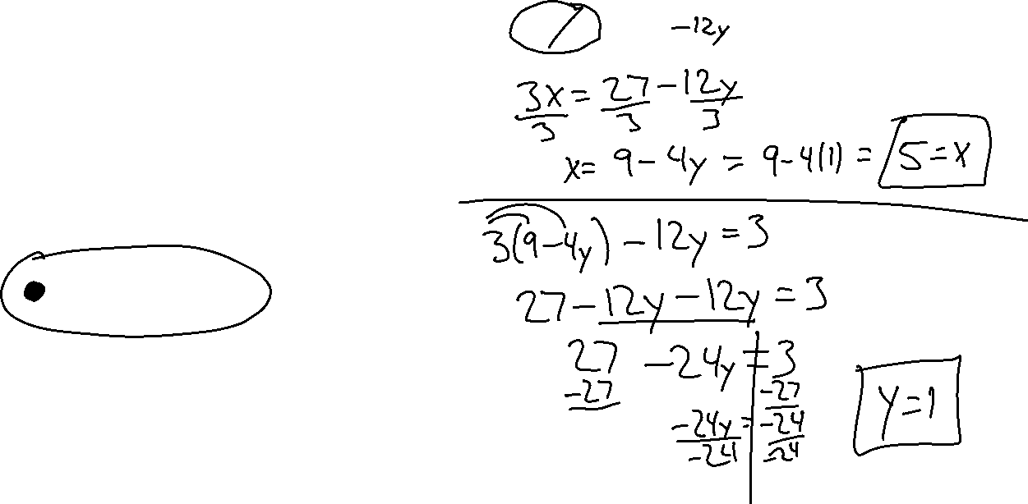

Slide 6
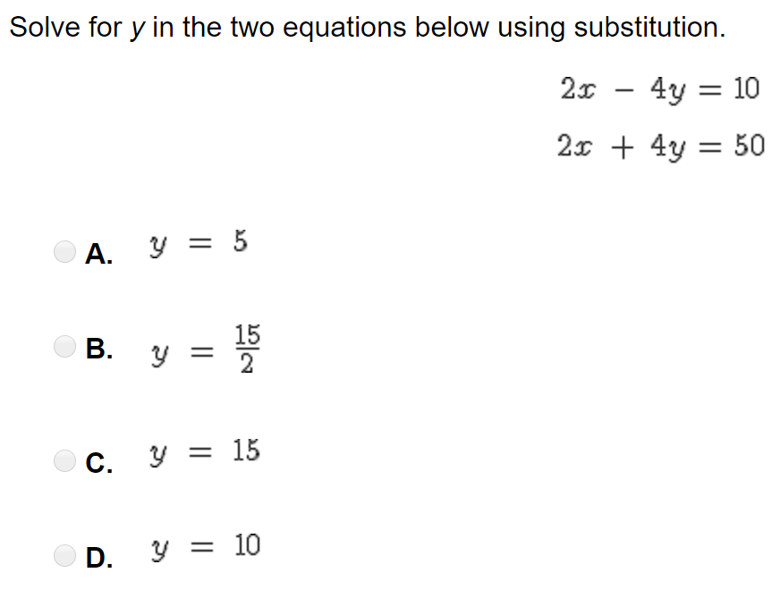
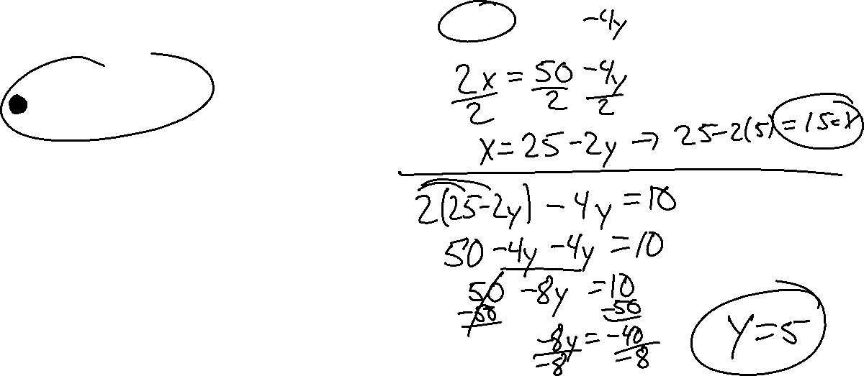

Slide 7
